Slide 1
Management Approaches
Presented By
Mubashir Ali
Saad Zaman
M Ammir
Ali Awais Khan
Ahmed Javeed

Slide 2
Table of Content
What is Management ?
Why We need management ?
Efficiency Vs Effectiveness ?
Four Functions of Management?
Adam Smith :”The Wealth of Nations “
Industrial Revelation ?
Types of Management approaches ?
Classical Vs Modern approach ?
Q / A Session .

Slide 3
What is management ?
“the process of dealing with or controlling things or people.”
Management is the art of knowing what you want to do and then seeing that it is done in the best and cheapest way.”
Management is a multipurpose organ that manage a business and manages Managers and manages Workers and work.”

Slide 4
why we need management
The reality that management is needed in all types and sizes of organizations , at all organizational levels , in all organizational areas , and in organizations no matter where located
Management in all business and organizational activities is the act of getting people together to accomplish desired goals and objectives using available resources efficiently and effectively.

Slide 5
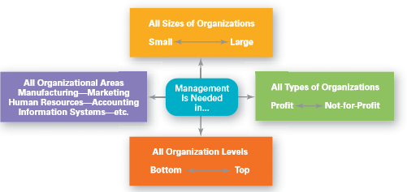
Every One Need Management

Slide 6
Efficiency Vs Effectiveness ?
Efficiency : Doing things right , or getting the most output from the least amount of inputs.
Effectiveness : Doing the right things , or completing activities so that organizational goals are attained

Slide 7
Four Function of Management
Planning
Organizing
Controlling
Leading

Slide 8
Four Function of Management
Planning : Management function that involves setting goals ,establishing strategies for achieving those goals , and developing plans to integrate and coordinate activities .
Organizing : Management function that involves arranging and structuring work to accomplish the organization’s goals.
Leading : Management function that involves working with and through people to accomplish organizational goals
Controlling Management function that involves monitoring , comparing , and correcting work performance:

Slide 9
Adam Smith
“The Wealth of Nations”
In 1776 Adam Smith publish his book “ The Wealth of Nations ” In Which he argued for economic and division of labor.
Division of labor means divide them on the basic of specialization.
He Claim that if 10 individuals each doing specialized task could make 4800 pins a day.
On the other hand if each person work alone he could only make 10 pins a day.

Slide 10
Industrial Revolution
In 18th Century When machine come into the power and industrial revolution can take place.
Industry produce more goods then its previous capacity.
Large Factories need someone who can manage his production and other matters more efficiently .
These Managers need some formal theories to guide them in running these large organizations

Slide 11
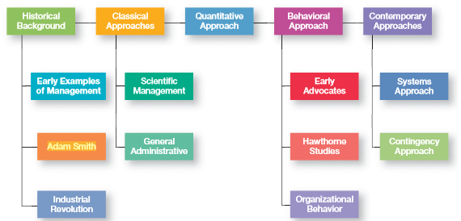
Majors Approaches of Management

Slide 12
Classical Approach
This Approach emphasized the rationality of and making organizations and workers as efficient as possible .
Two major theories also comprise the classical approach.
Administrative Approach
Scientific Approach

Slide 13
Scientific Approach
Scientific approach define as choosing the best way to perform a task.
Its main objective is improving economic efficiency.
It was one of the earliest attempts to apply science to the engineering of processes and to management specially labor productivity.

Slide 14
Administrative Approach
An approach to management that focuses on describing what managers do and what constitutes good management practice
The theory generally calls for a formalized administrative structure, a clear division of labor.
power and authority to administrators relevant to their areas of responsibilities

Slide 15
Quantitative Approach
The use of quantitative techniques to improve decision making
The qualitative approach to research is focused on understanding a phenomenon from a closer perspective.
The quantitative approach tends to approximate phenomena from a larger number of individuals using survey methods

Slide 16
Behavioral Approach
The study of the actions of people at work
Motivating, leading, building trust, working with a team, managing conflict, and so forth—has come out of OB research.
OB Is performance oriented
Ob is a way of thinking.
Individuals and groups behavior at work lead to organization performance

Slide 17
Contemporary Approaches
Contemporary approaches means new ,recent or current approaches in the field of management.
Further Two Types of Contemporary approaches.
Open System
Closed System

Slide 18
Open System
Systems that interact with their environment
An open system is a system that regularly exchanges feedback with its external environment
Open systems are systems, of course, so inputs, processes, outputs, goals, assessment and evaluation, and learning are all important.

Slide 19
Closed System
Systems that are not influenced by and do not interact with their environment
Closed systems with outputs are knowable only thorough their outputs which are not dependent on the system being a closed or open system.
Closed systems without any output are knowable only from within. See also entropy.

Slide 20
Q/A
?

Slide 21
Thank You!

